Slide 1
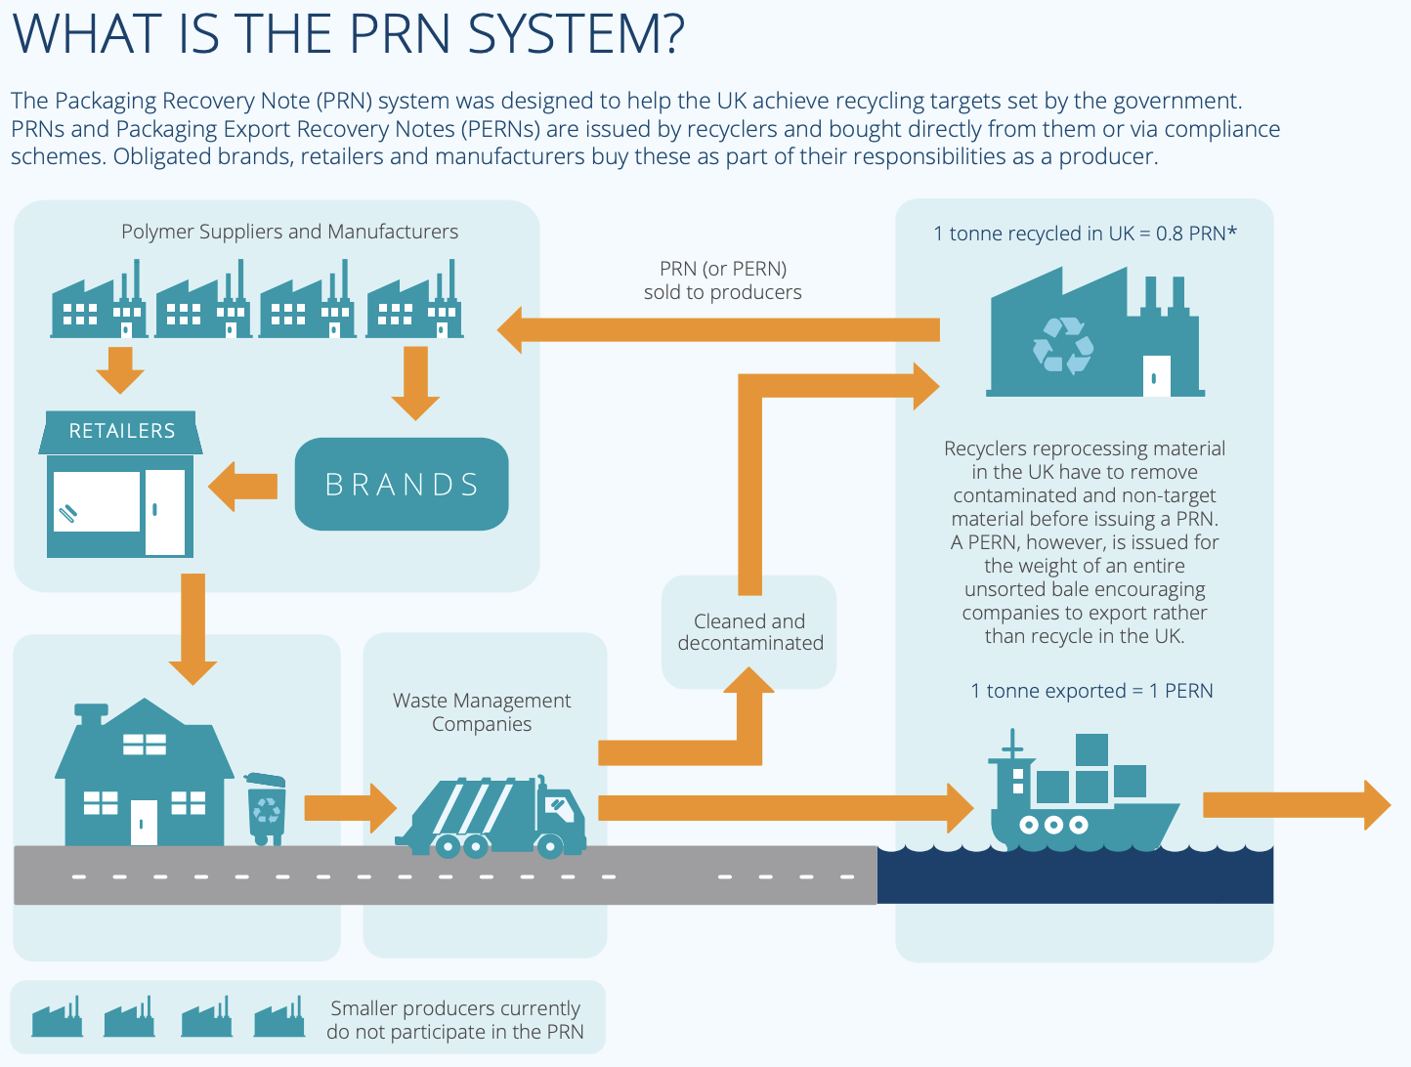
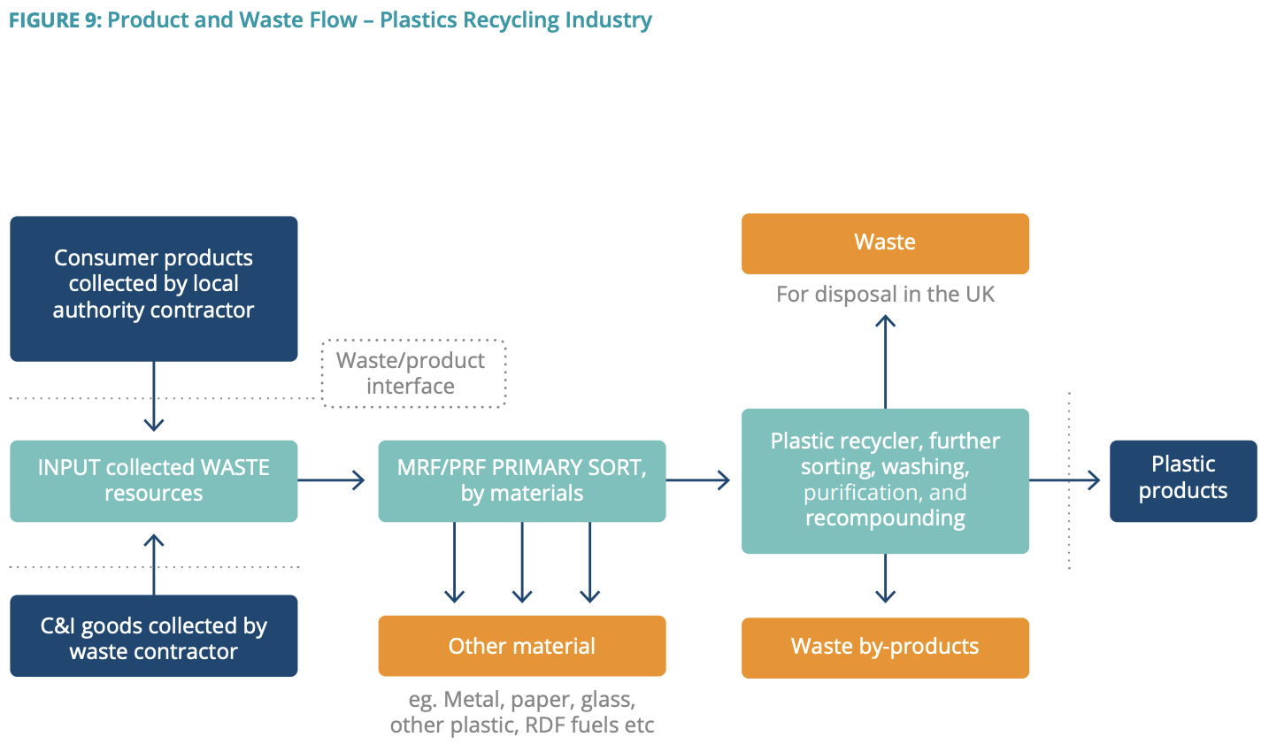
Reference: https://www.bpf.co.uk/roadmap

Slide 2
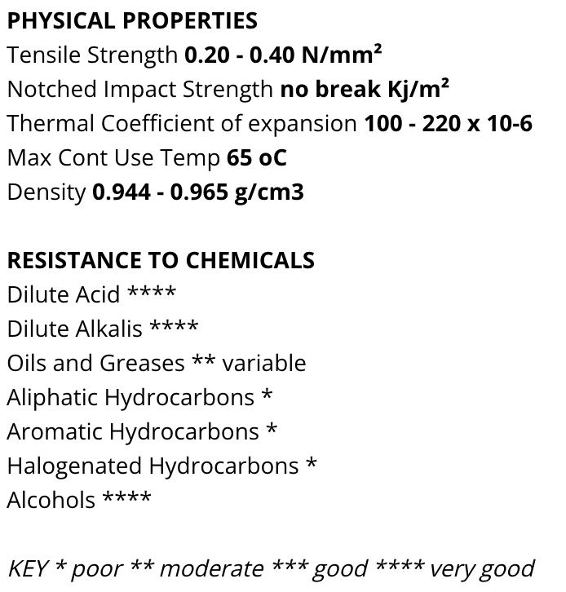

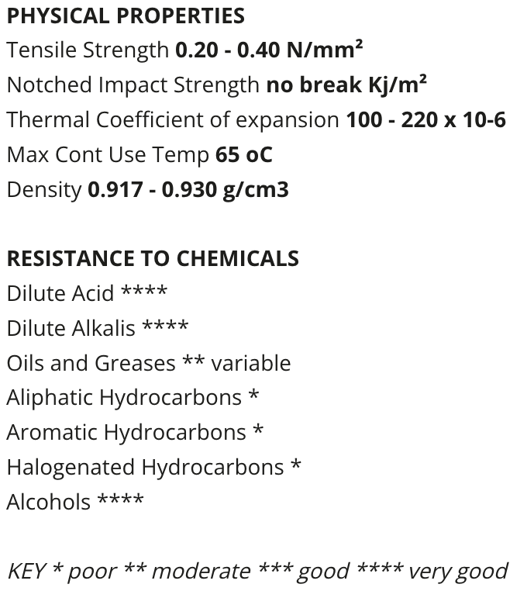

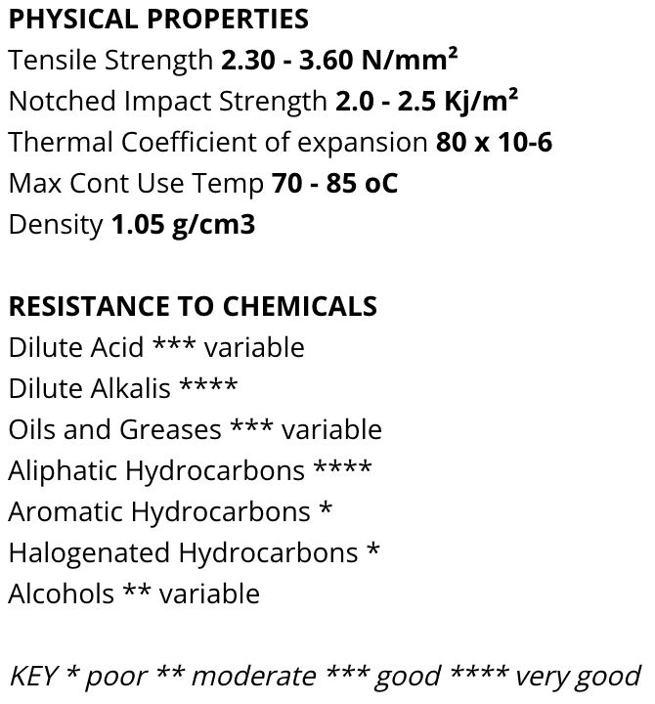

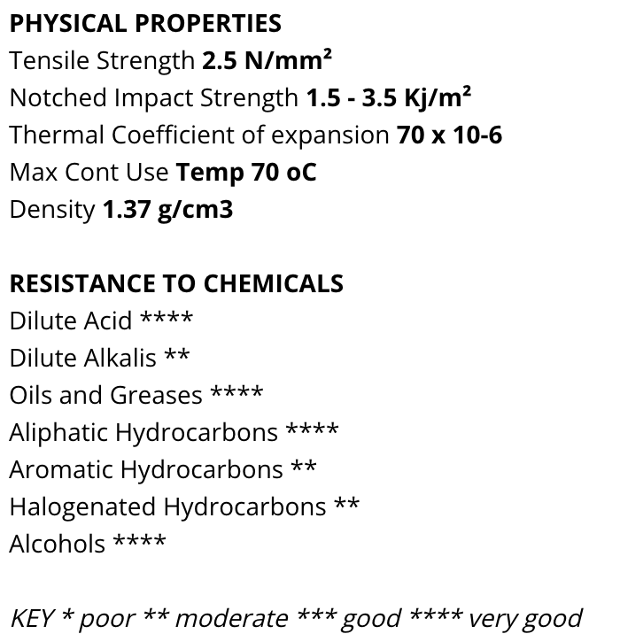

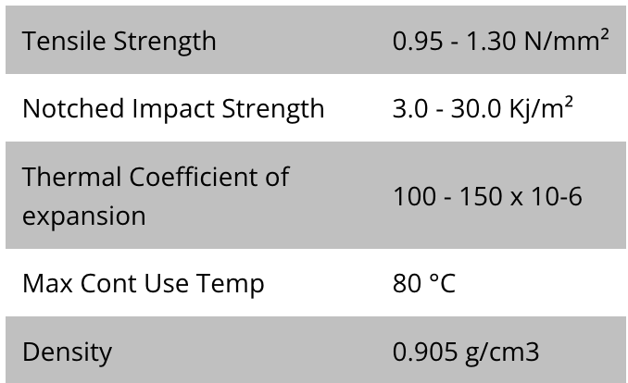
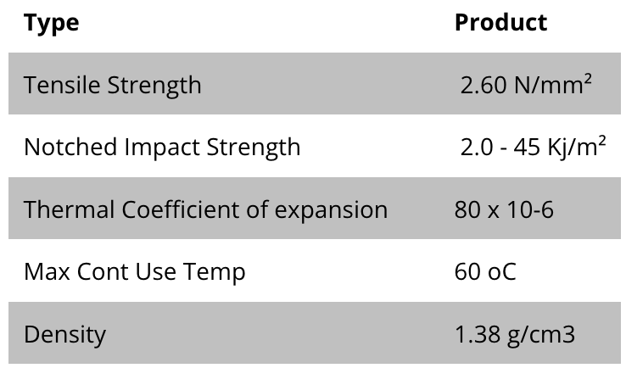


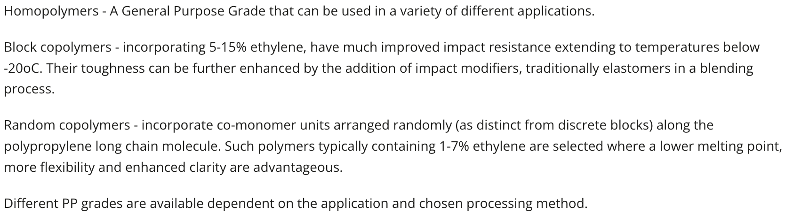
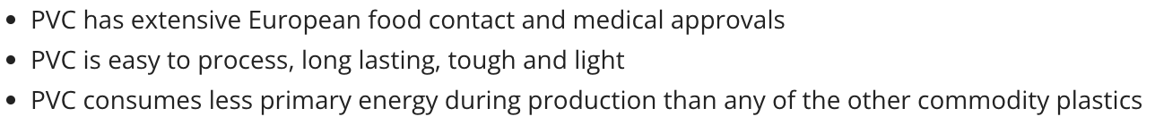
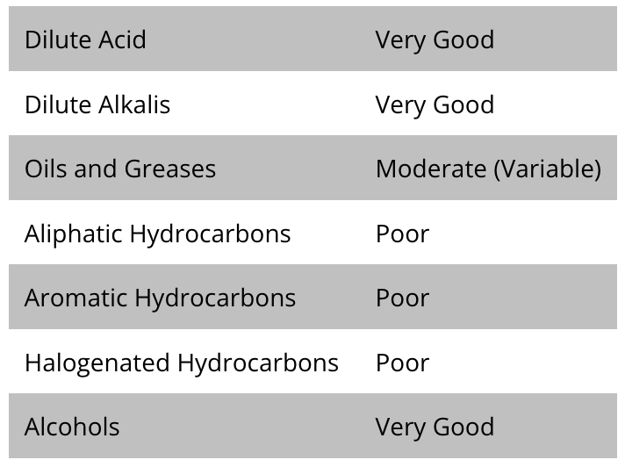
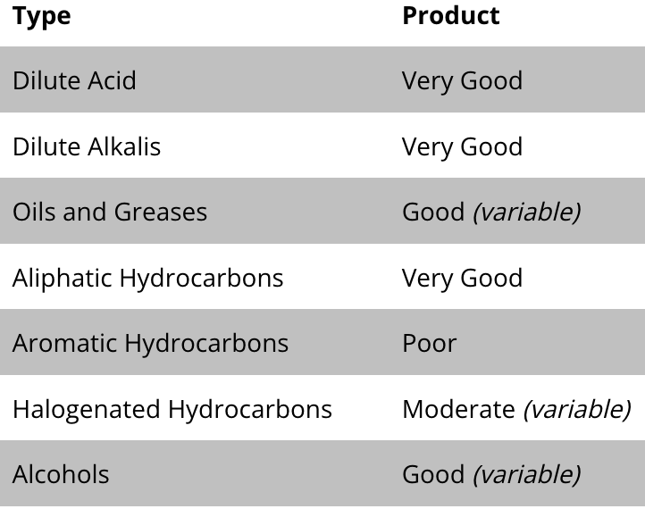
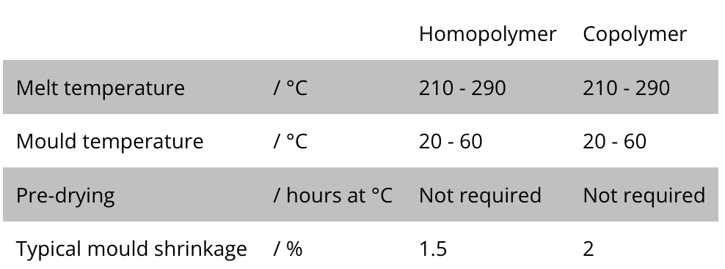
EU Plastics Data
Reference: [1]https://www.bpf.co.uk/Sustainability/Plastics_Recycling.aspx#:~:text=Once%20the%20plastic%20is%20collected,be%20used%20in%20new%20products
Polyesters (Thermoplastics): PETP, PBT, PET
Polyethylene (High density) HDPE
Polyethylene (Low density) LDPE
Polystyrene PS
100% recyclable egg boxes
100% recyclable bottles
)
Polypropylene PP
Polyvinyl Chloride PVC
biaxially oriented film (OPP)

Slide 3
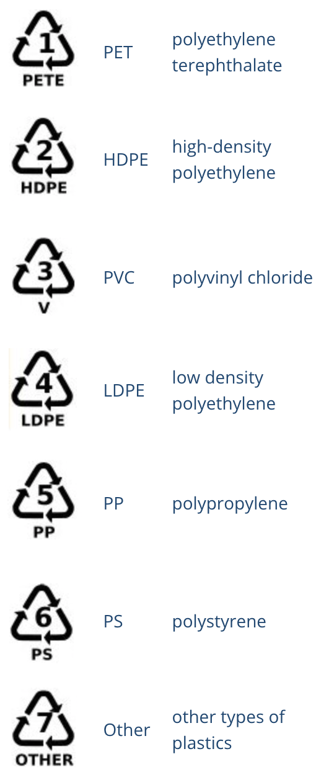
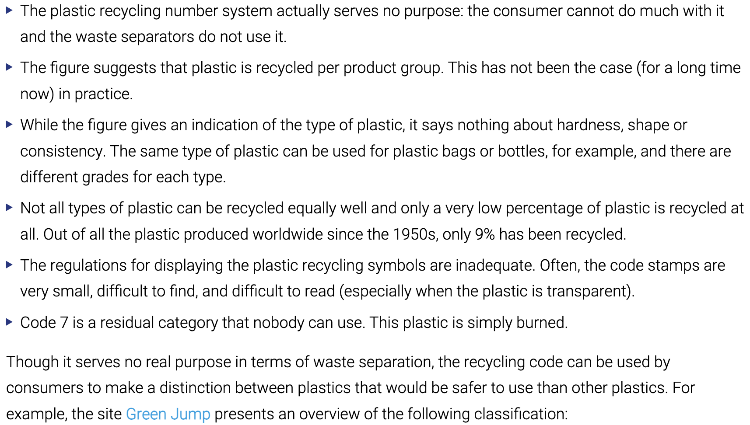
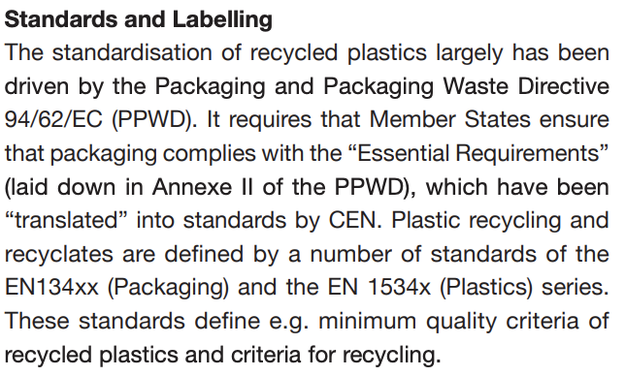
Recycling Symbols Explanations
References:
[1] https://www.bpf.co.uk/Sustainability/Plastics_Recycling.aspx#:~:text=Once%20the%20plastic%20is%20collected,be%20used%20in%20new%20products
[2] https://www.plasticsoupfoundation.org/en/plastic-problem/what-is-plastic/recycling-codes/
[3] https://docs.european-bioplastics.org/publications/bp/EUBP_BP_Mechanical_recycling.pdf

Slide 4
Types and Routes of Recyling
For the slides below …

Slide 5
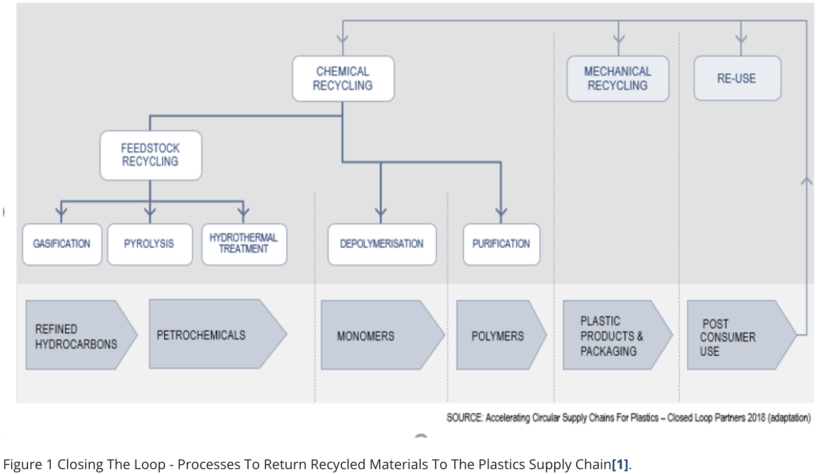
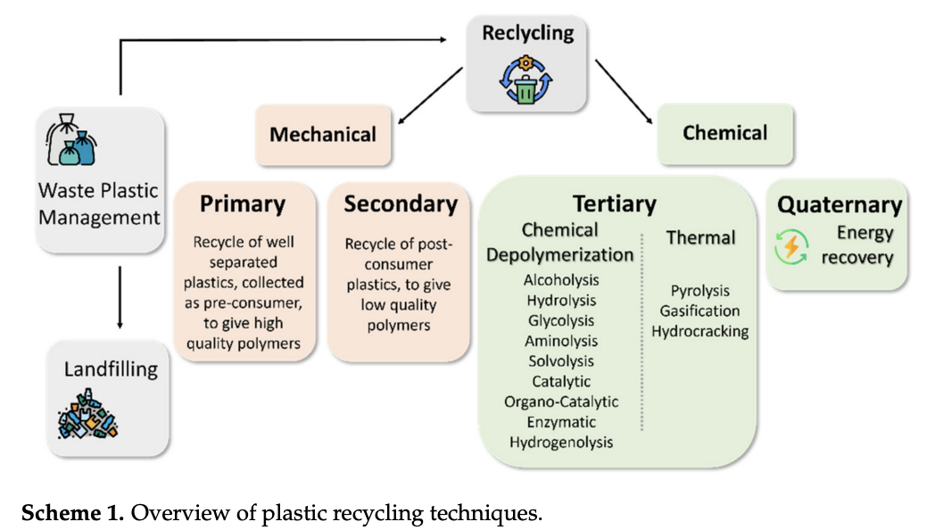
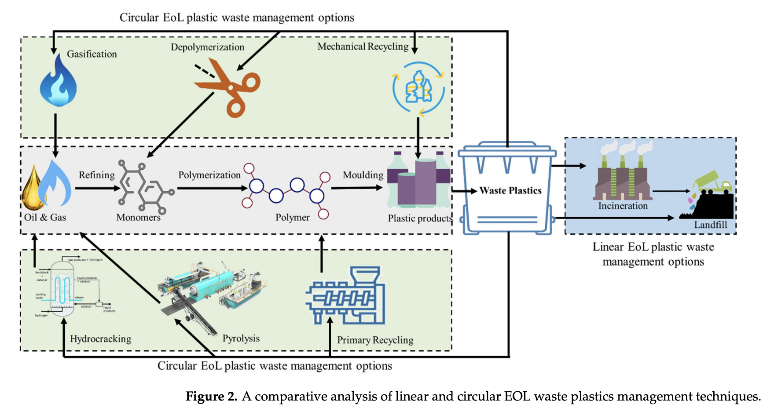
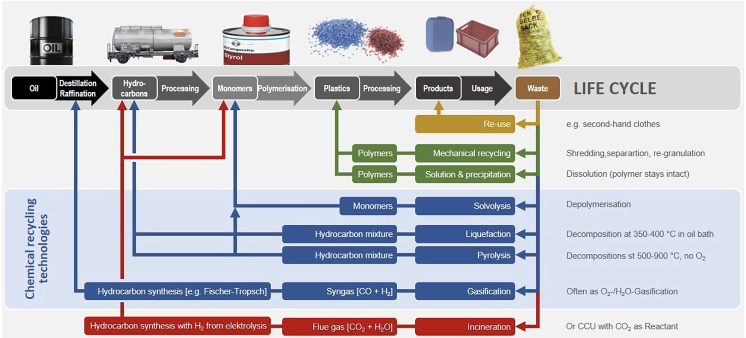
Routes
References:
[1] https://www.bpf.co.uk/plastipedia/chemical-recycling-101.aspx
[2]https://journals.sagepub.com/doi/epub/10.1177/0734242X221084044
[3] https://www.mdpi.com/1996-1944/14/17/4782
[4] https://www.mdpi.com/1420-3049/27/22/8084

Slide 6
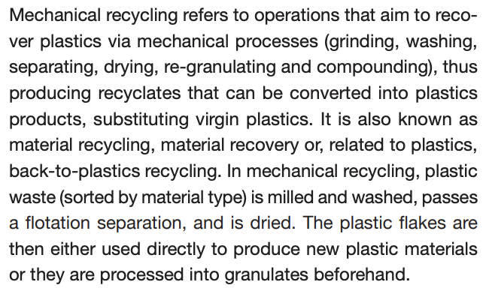
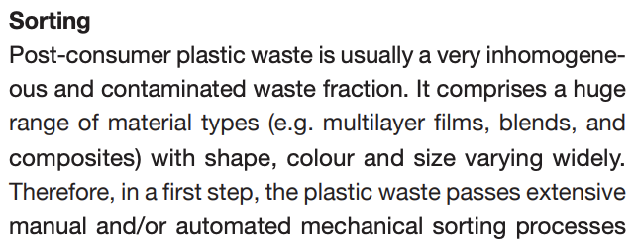
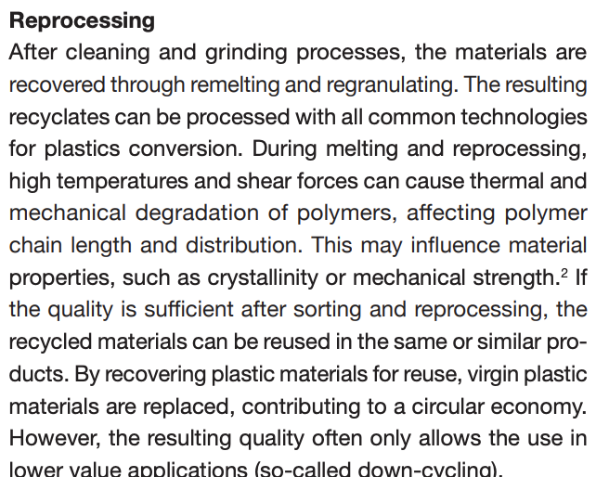
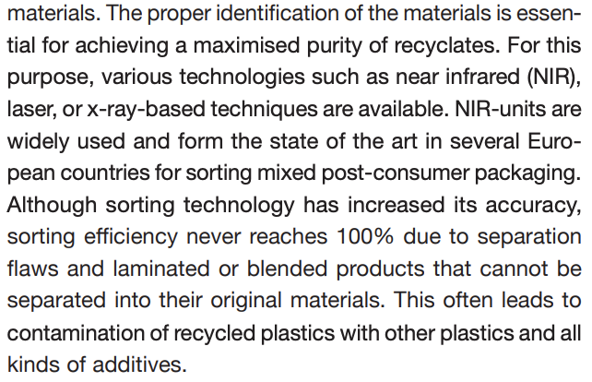
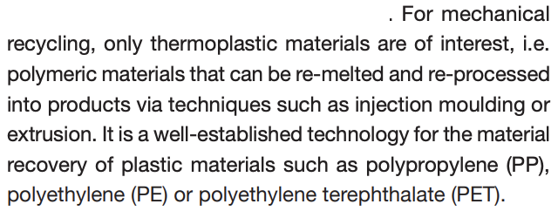
Mechanical Recycling (General in the EU)
Reference: [1]https://www.bpf.co.uk/plastipedia/sustainability/how-is-plastic-recycled-a-step-by-step-guide-to-recycling.aspx#:~:text=Mechanical%20recycling%20uses%20grinding%2C%20washing,the%20use%20of%20virgin%20plastics.
[2]
Sorting
Cleaning
Grinding
Re-melting
Re-granulation

Slide 7
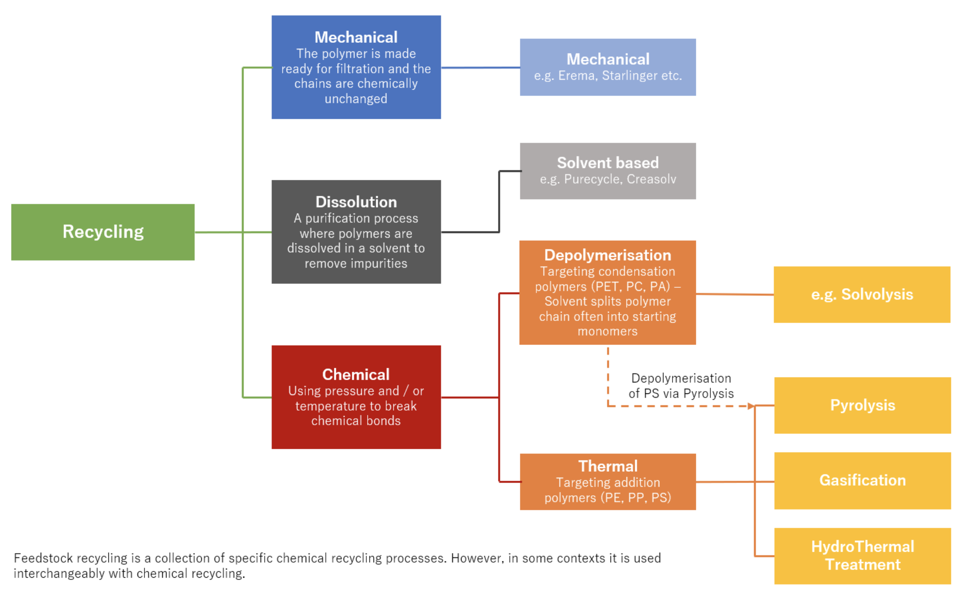
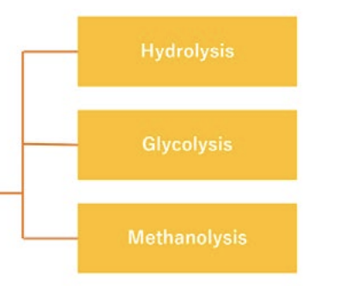
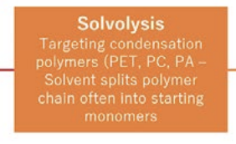
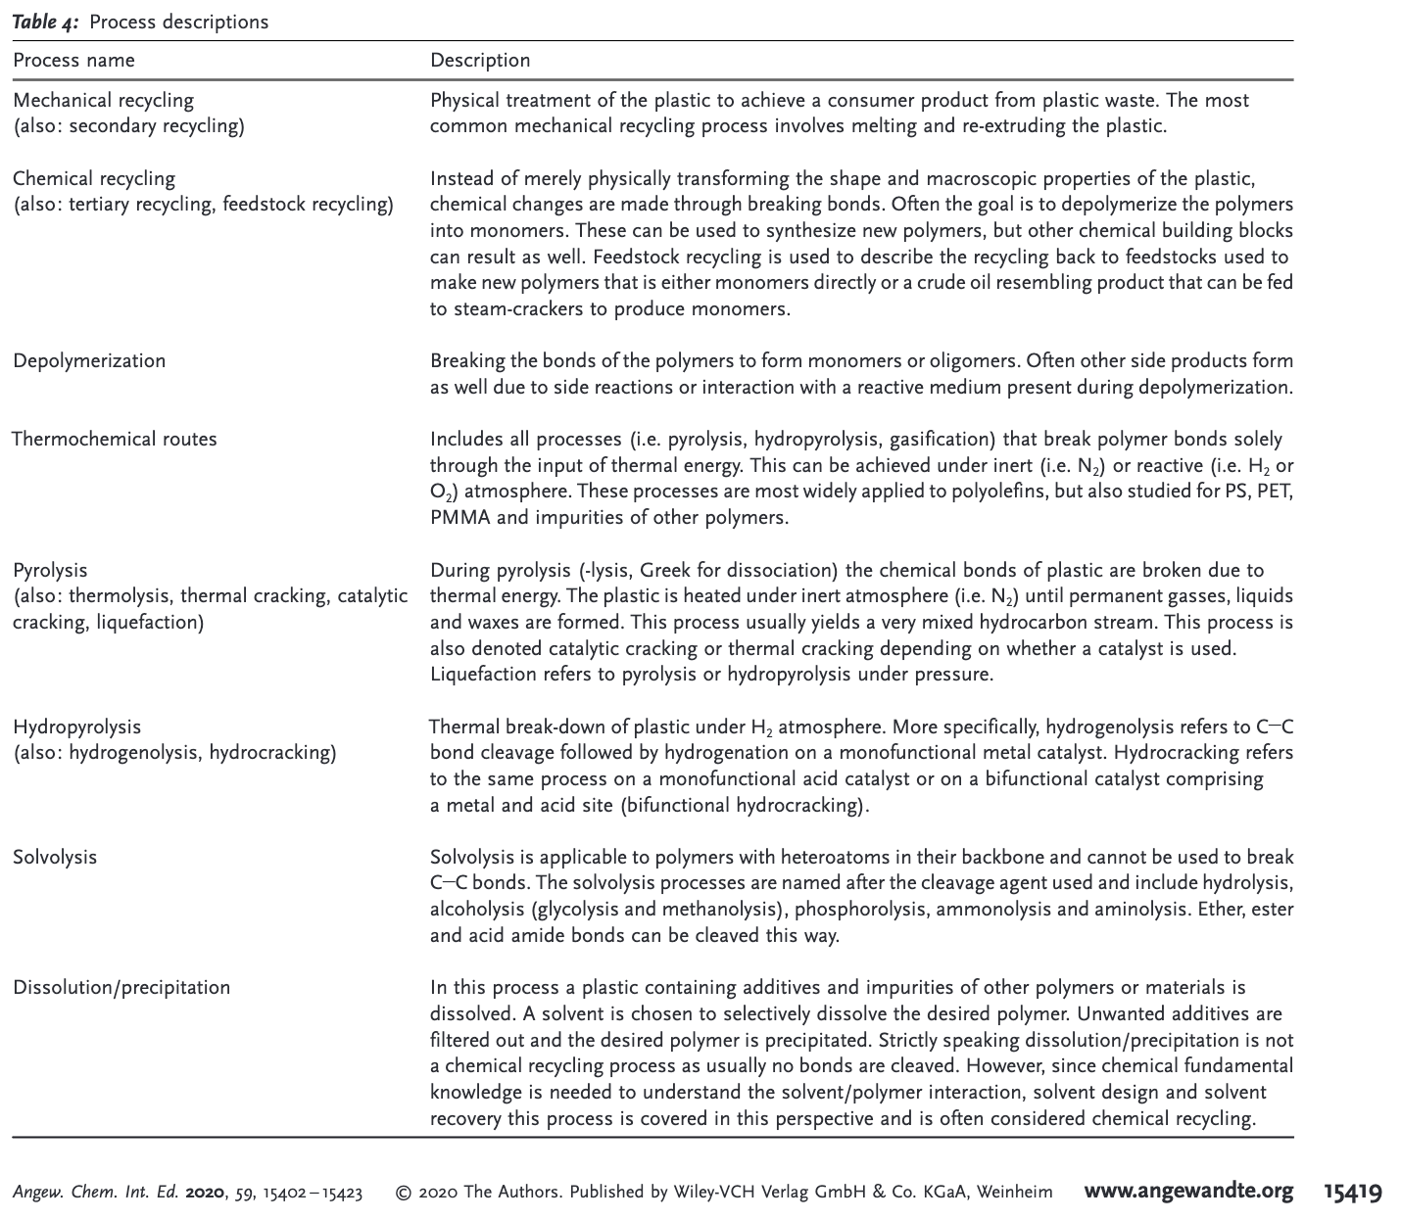
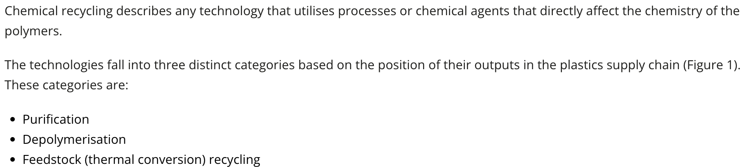
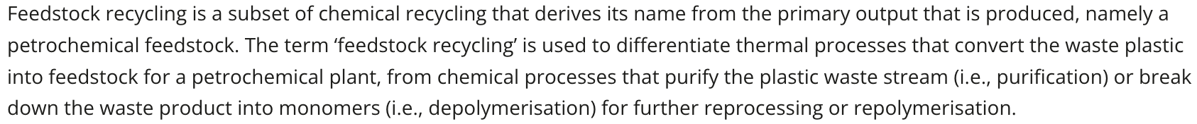
Chemical Recycling
Reference:
[1]https://onlinelibrary.wiley.com/doi/epdf/10.1002/anie.201915651

Slide 8
Energy Recovery Recycling
Reference:
[1]
[2]

Slide 9
Landfill Recycling
Reference:
[1]https://www.theconsumergoodsforum.com/wp-content/uploads/2022/04/Life-Cycle-Assessment-of-Chemical-Recycling-for-Food-Grade-Film.pdf
[2]

Slide 10
Chemical Recycling
For the slides below …

Slide 11
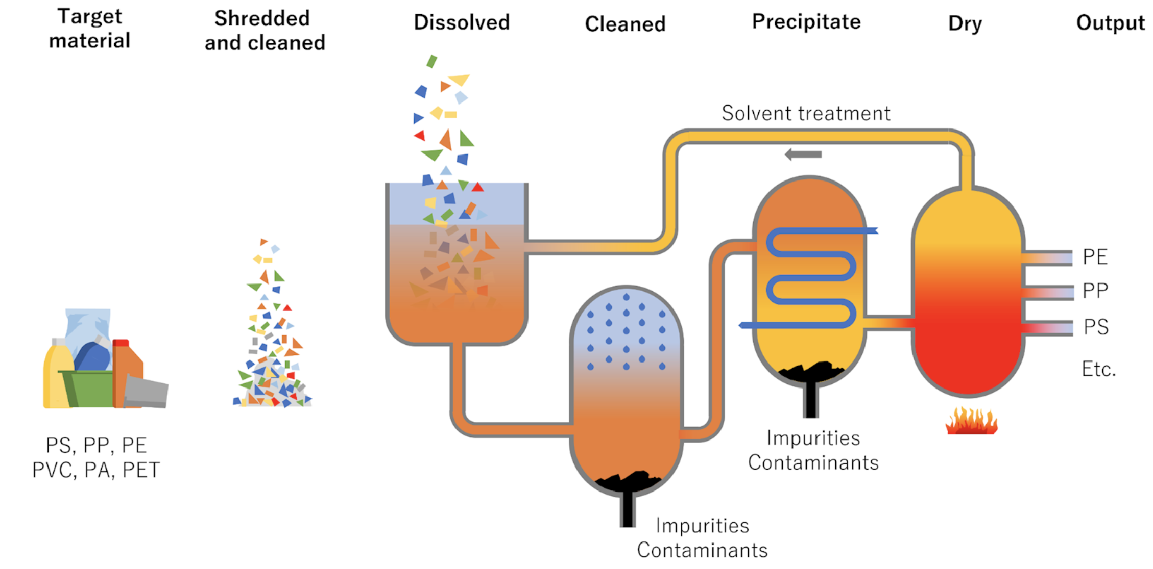
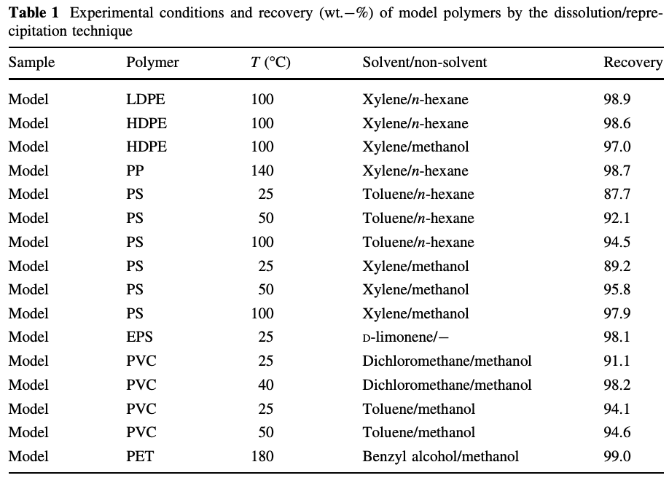
Dissolution Recycling
Reference:
[1] https://www.bpf.co.uk/hub/overview-of-key-processes.aspx
[2]https://link.springer.com/article/10.1007/s00289-009-0104-5

Slide 12
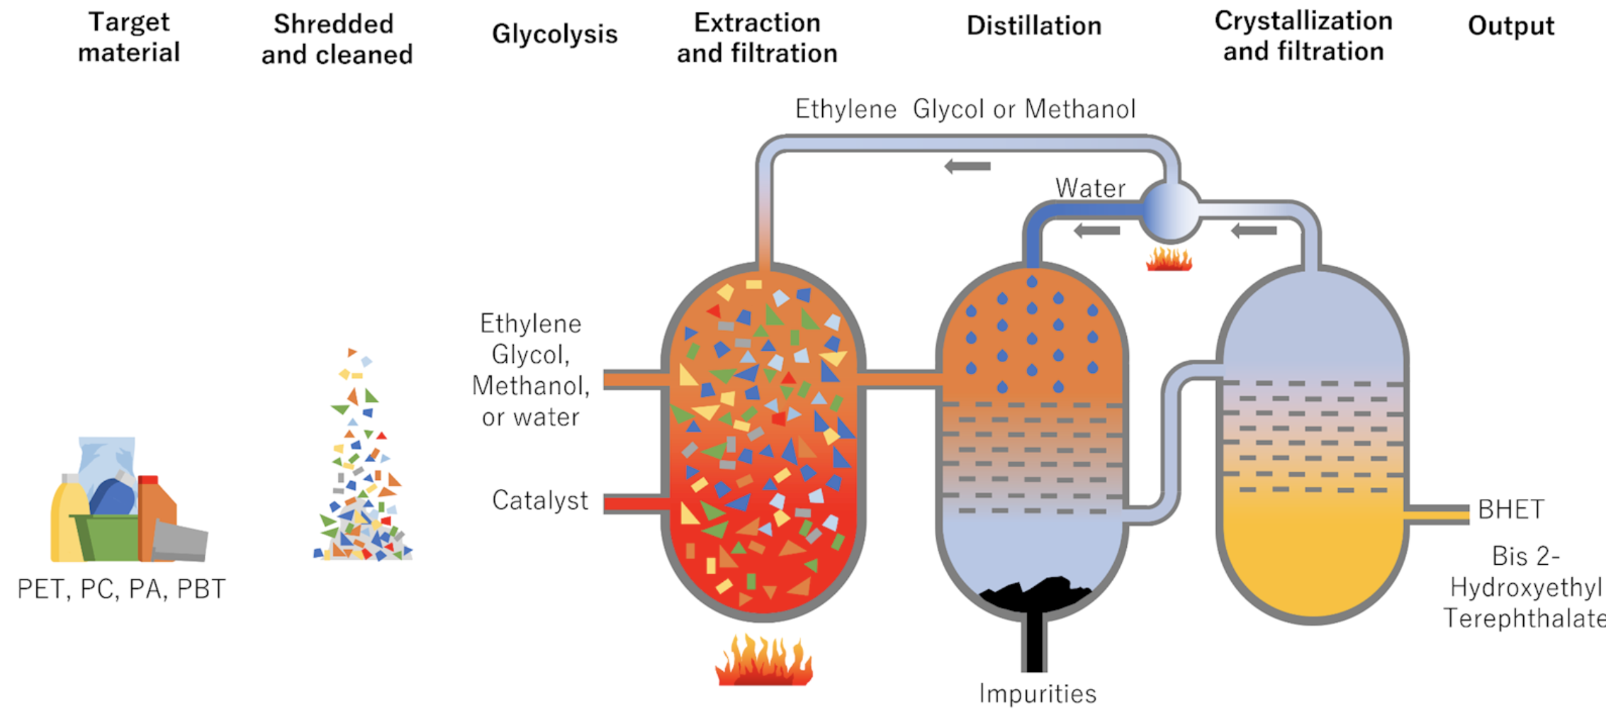
Chemical - Solvolysis (also: Hydrolysis, Methanolysis, Glycolysis)
Reference:
[1] https://www.bpf.co.uk/hub/overview-of-key-processes.aspx
[2]

Slide 13
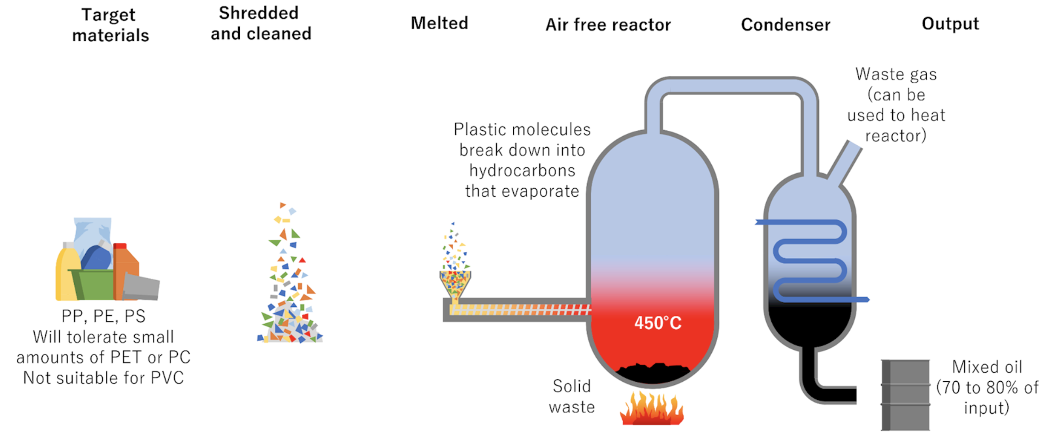
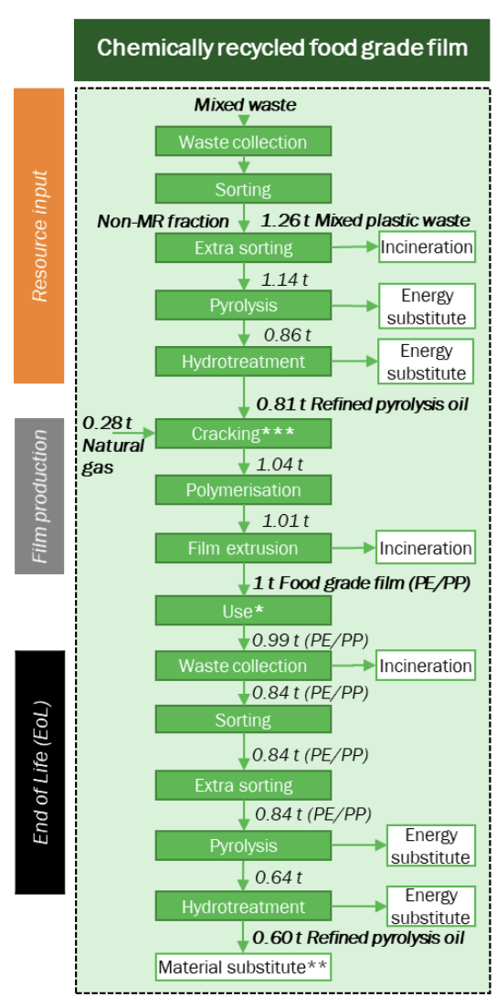
Chemical - Pyrolysis
Reference:
[1] https://www.bpf.co.uk/hub/overview-of-key-processes.aspx
[2]https://www.theconsumergoodsforum.com/wp-content/uploads/2022/04/Life-Cycle-Assessment-of-Chemical-Recycling-for-Food-Grade-Film.pdf

Slide 14
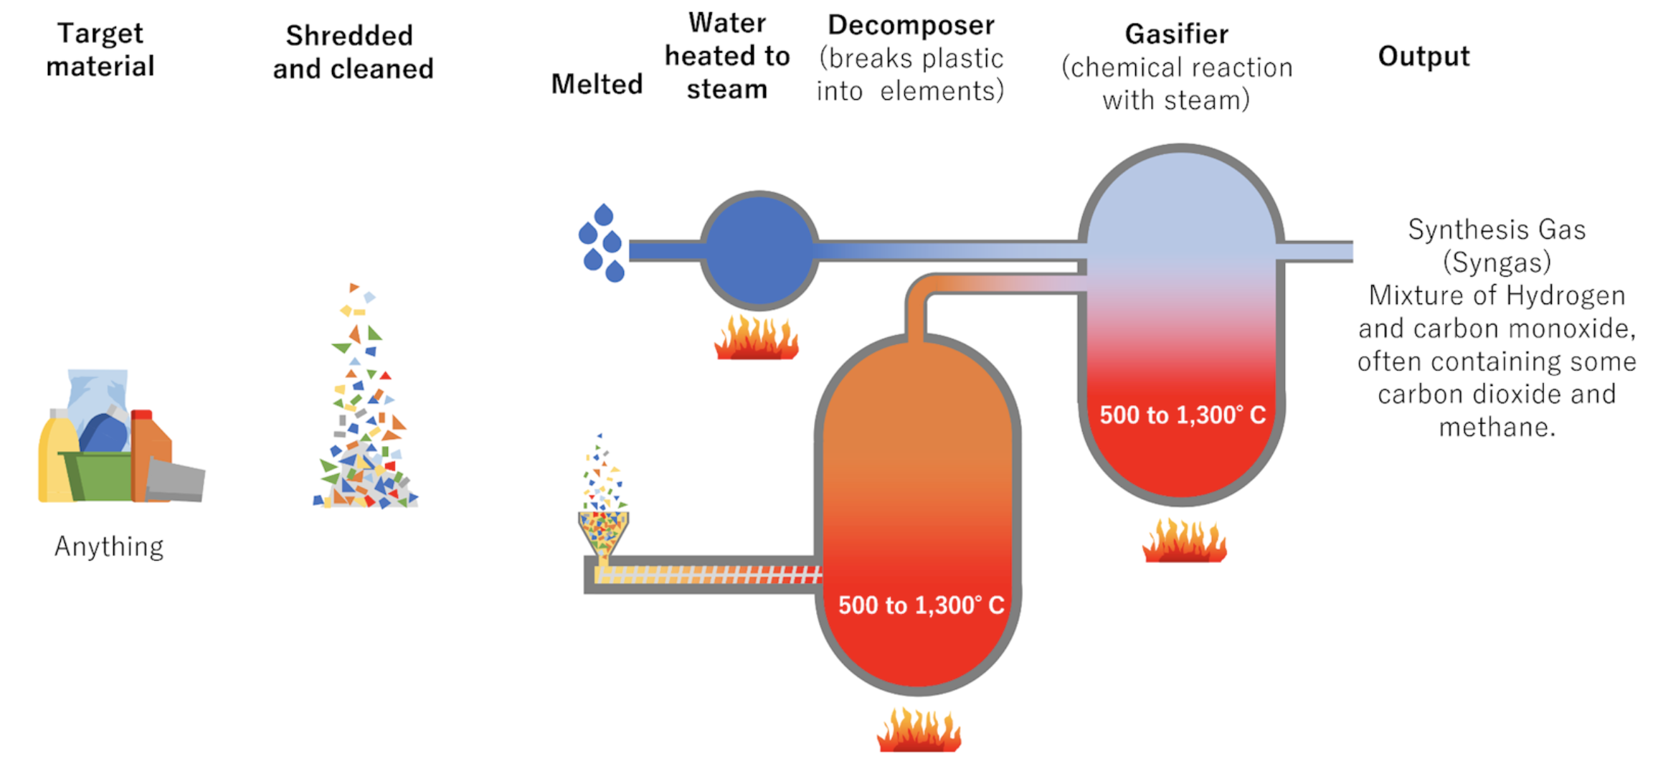
Chemical - Gasification
Reference:
[1] https://www.bpf.co.uk/hub/overview-of-key-processes.aspx
[2]

Slide 15
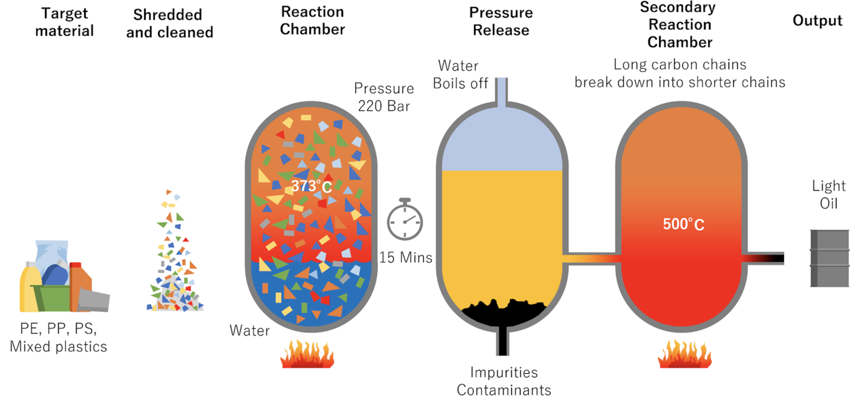
Chemical – Hydrothermal Treatment
Reference:
[1] https://www.bpf.co.uk/hub/overview-of-key-processes.aspx
[2]

Slide 16
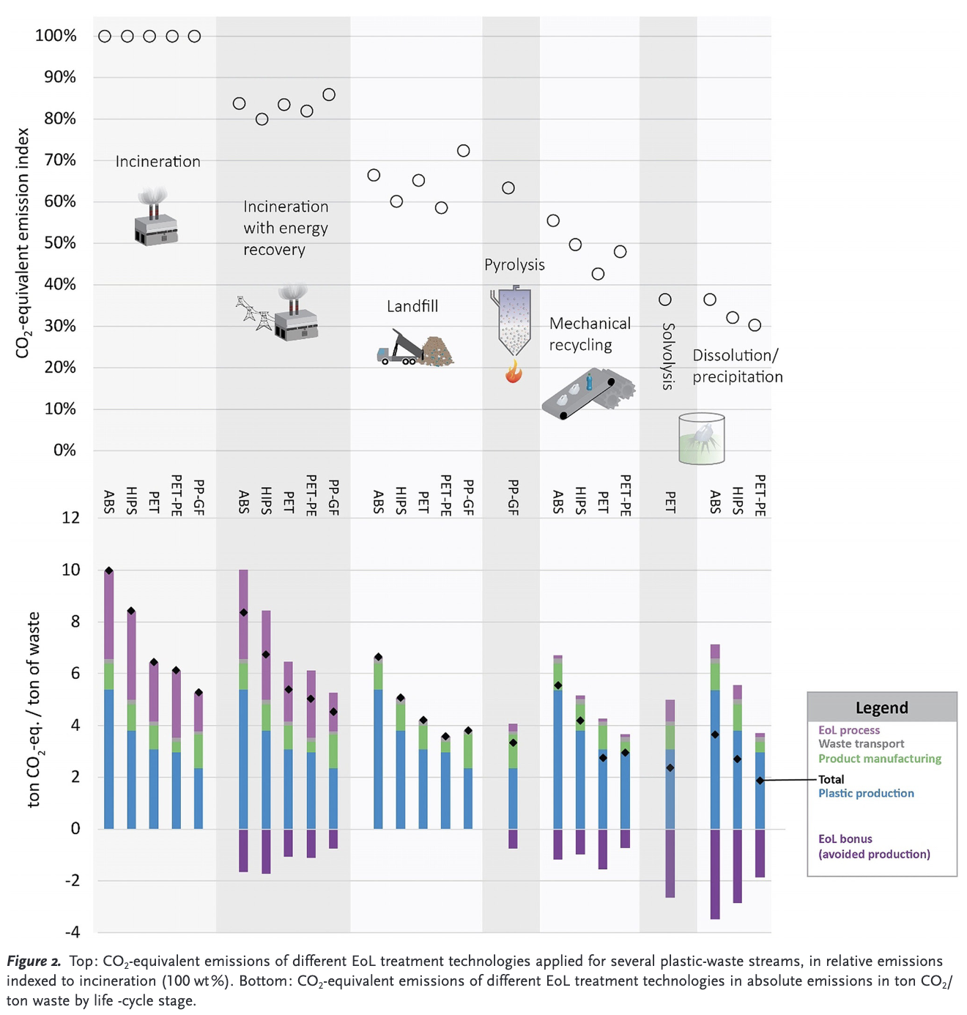
EU (Netherlands) Statistics for Emissions
Reference:
[1]https://onlinelibrary.wiley.com/doi/epdf/10.1002/anie.201915651
[2]

Slide 17
UK / EU General Recycling of Plastics
For the slides below …

Slide 18
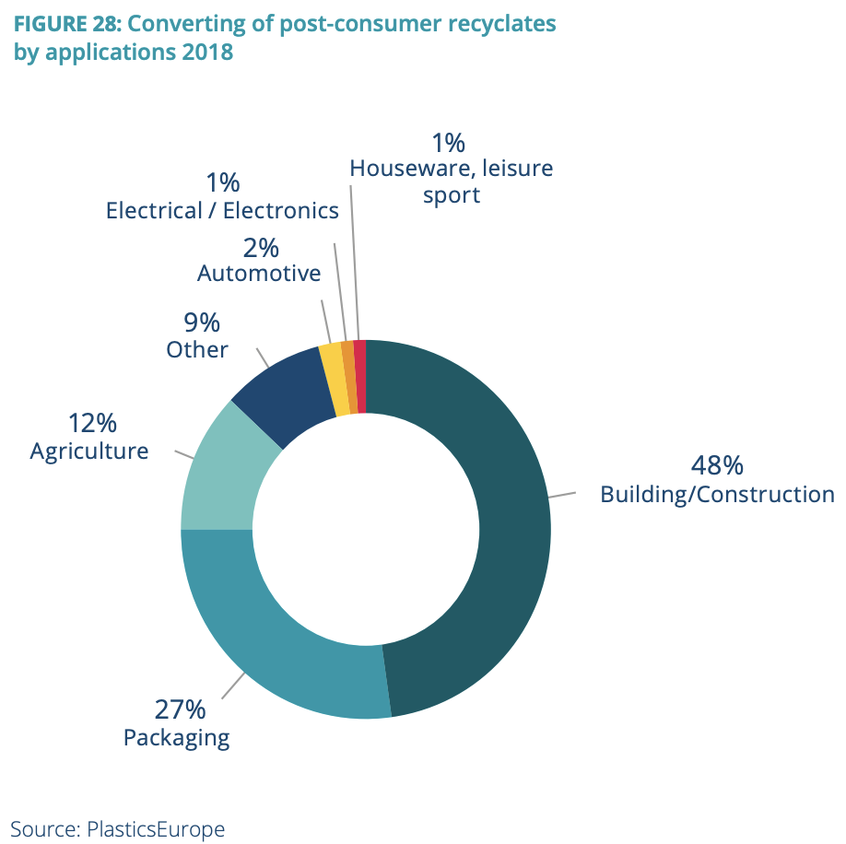
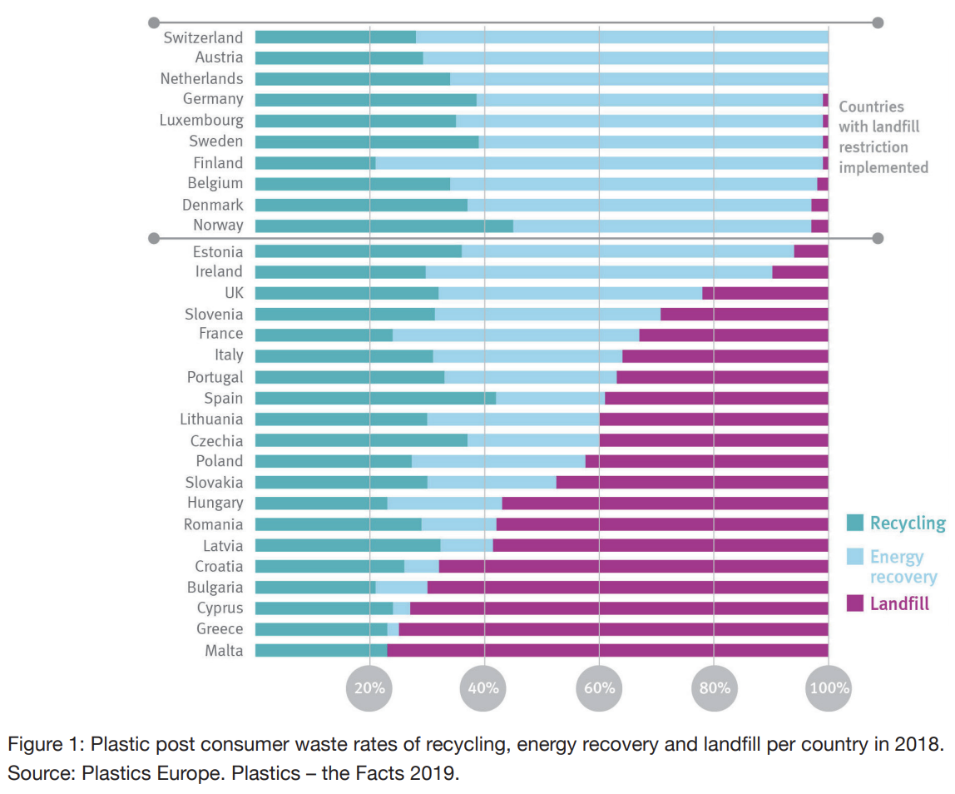
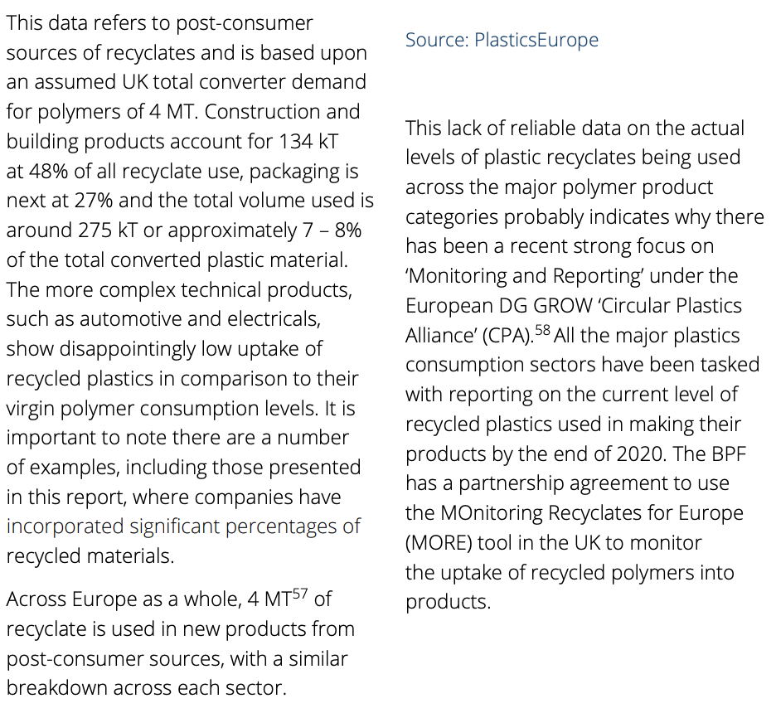
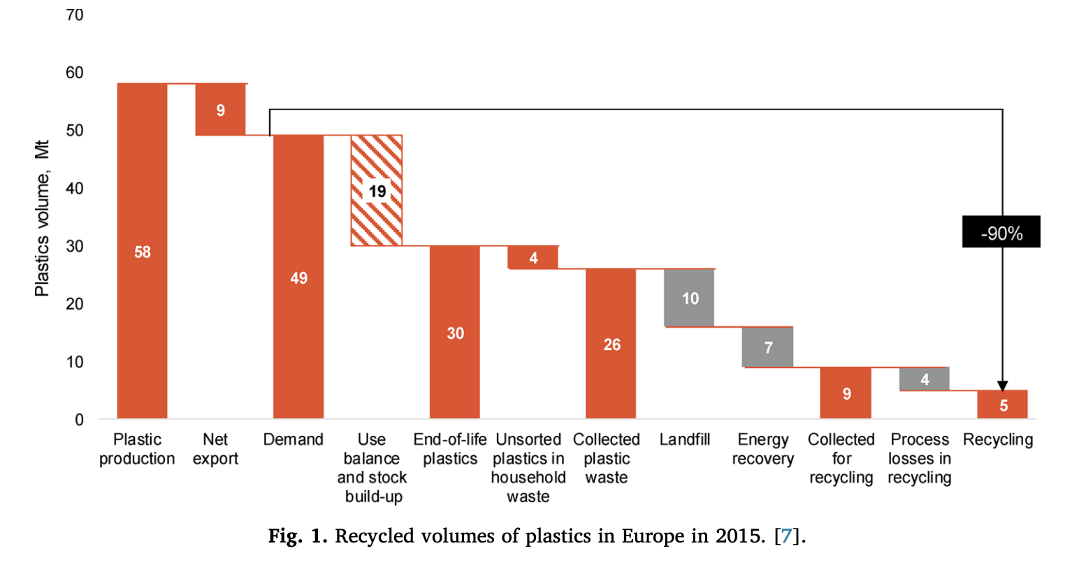
UK use of recycled plastics (2018)
References:
[1] https://www.bpf.co.uk/roadmap
[2] https://docs.european-bioplastics.org/publications/bp/EUBP_BP_Mechanical_recycling.pdf
[4]https://www.sciencedirect.com/science/article/pii/S0165237019308241?casa_token=4PSP4WWU_nMAAAAA:C2bfBXsLHy-2h6UUCE80jYd0VUZp8aU14UZl4cKpRP4ZYwlL6lP3D1LgR3aAGdzaPI0C6AiBDEE

Slide 19
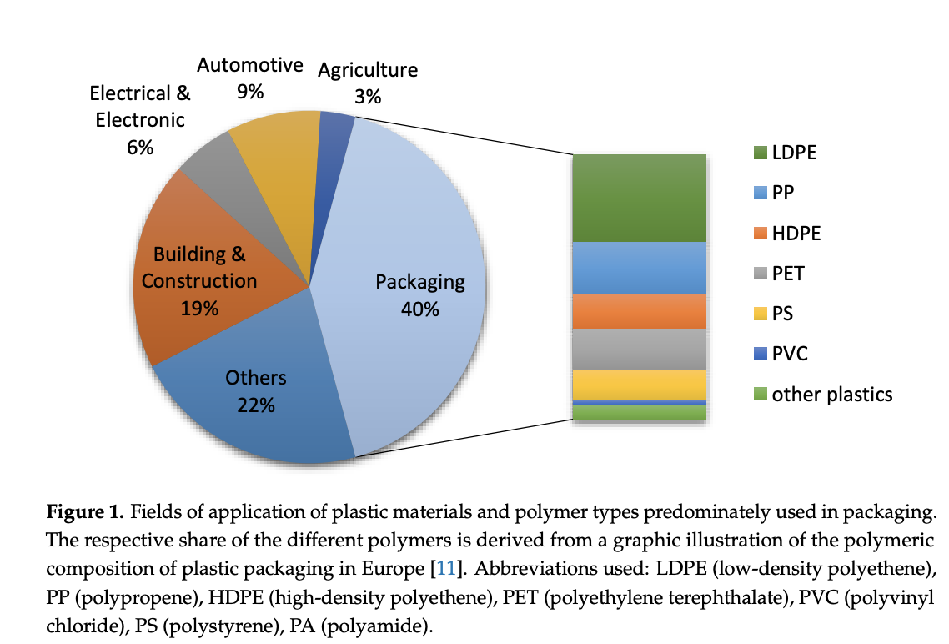
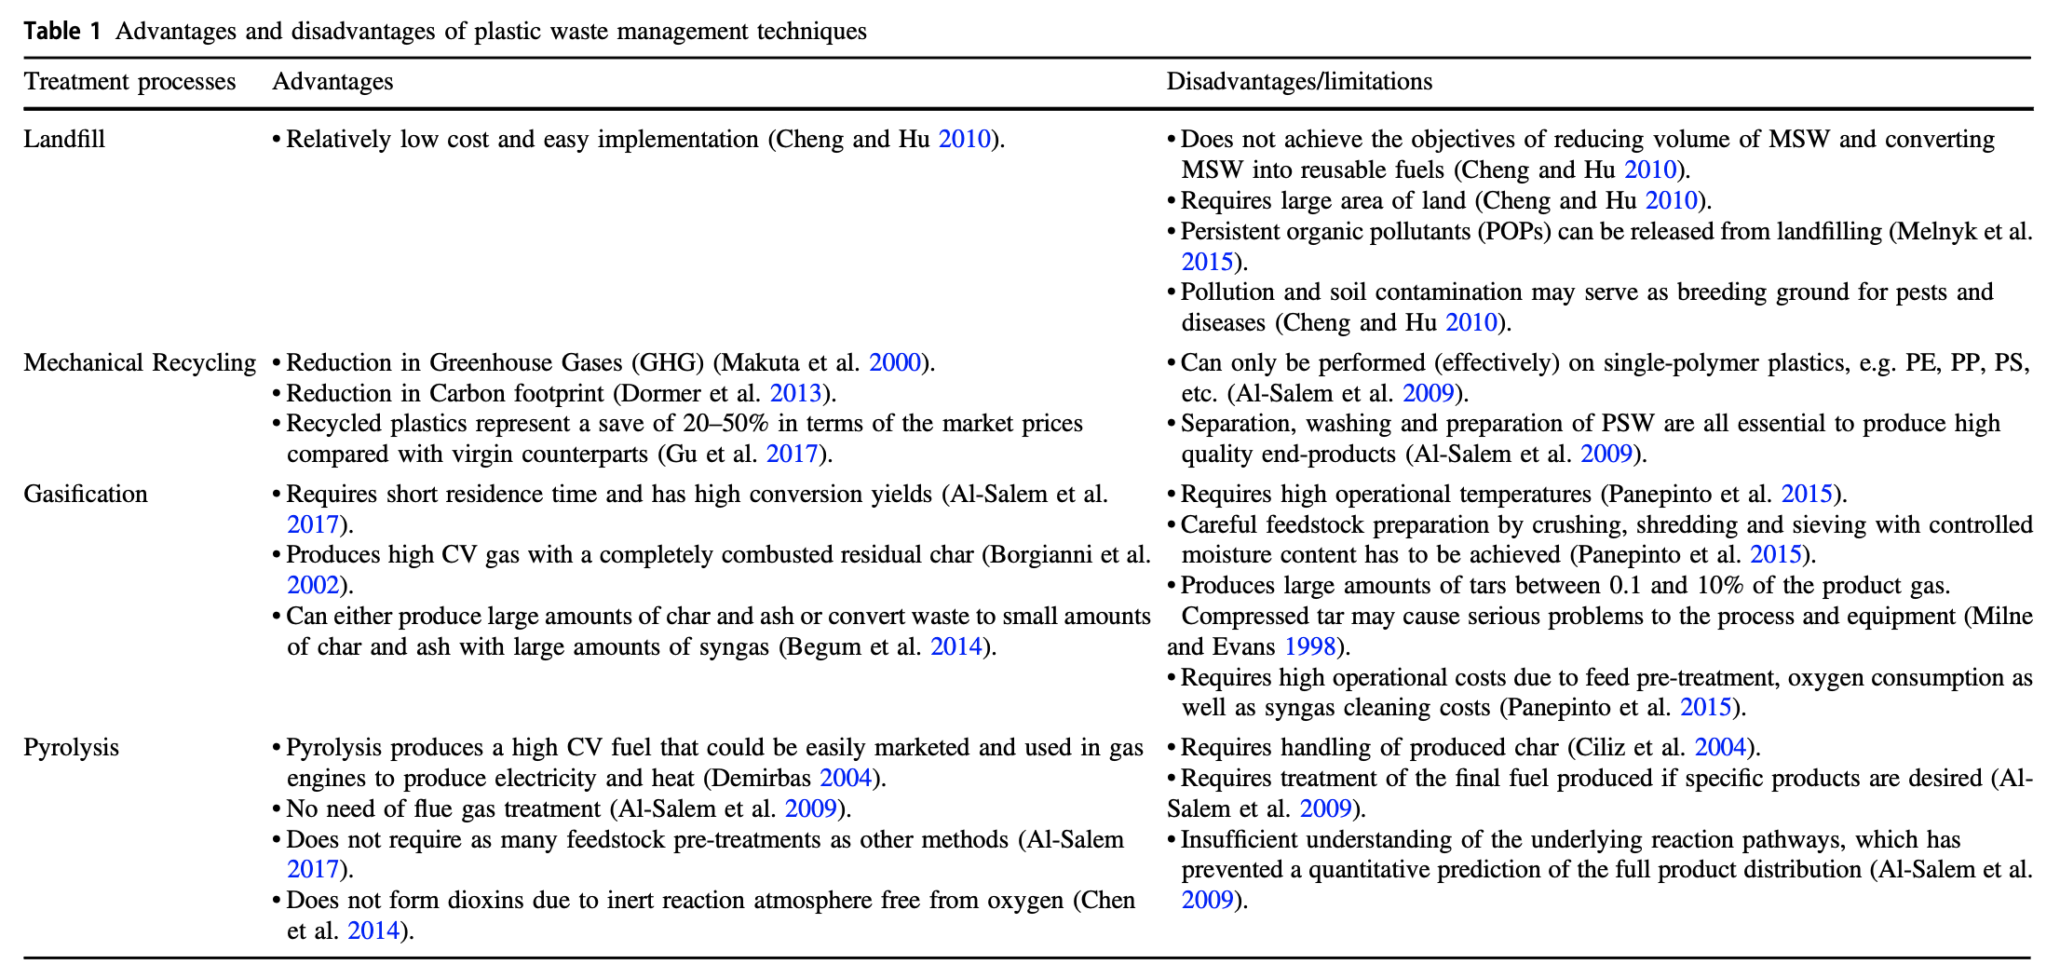
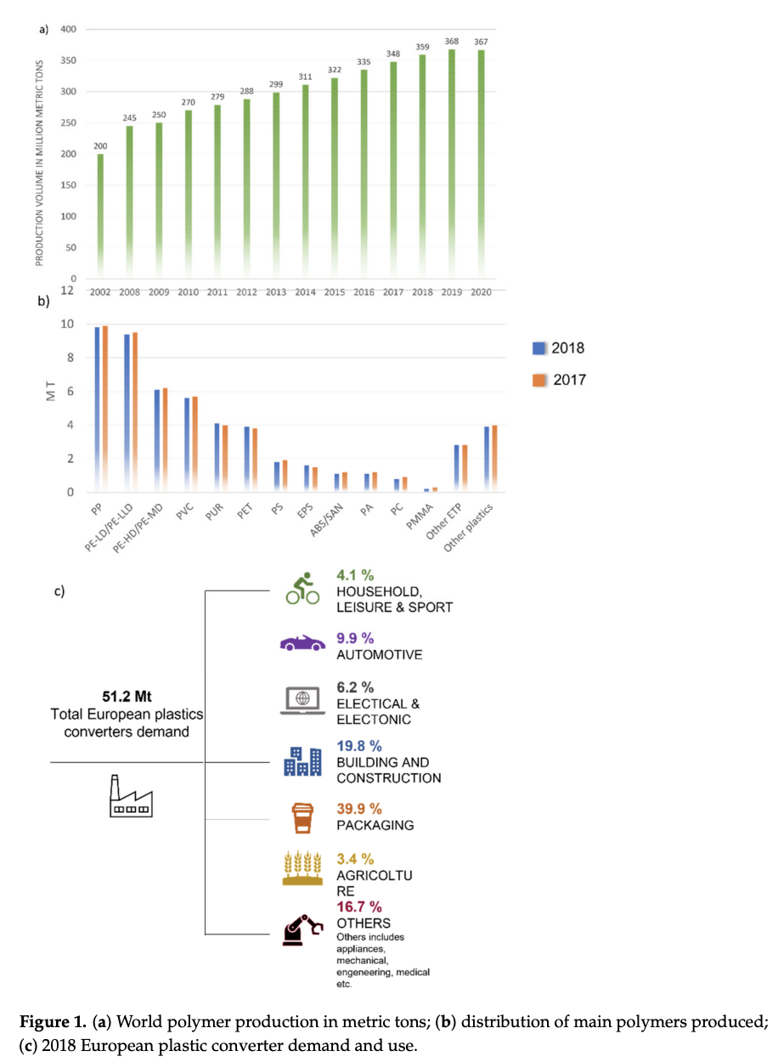
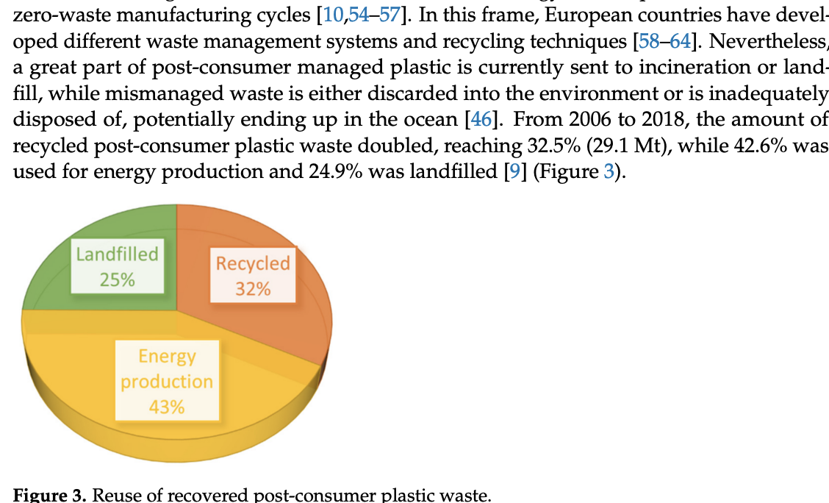
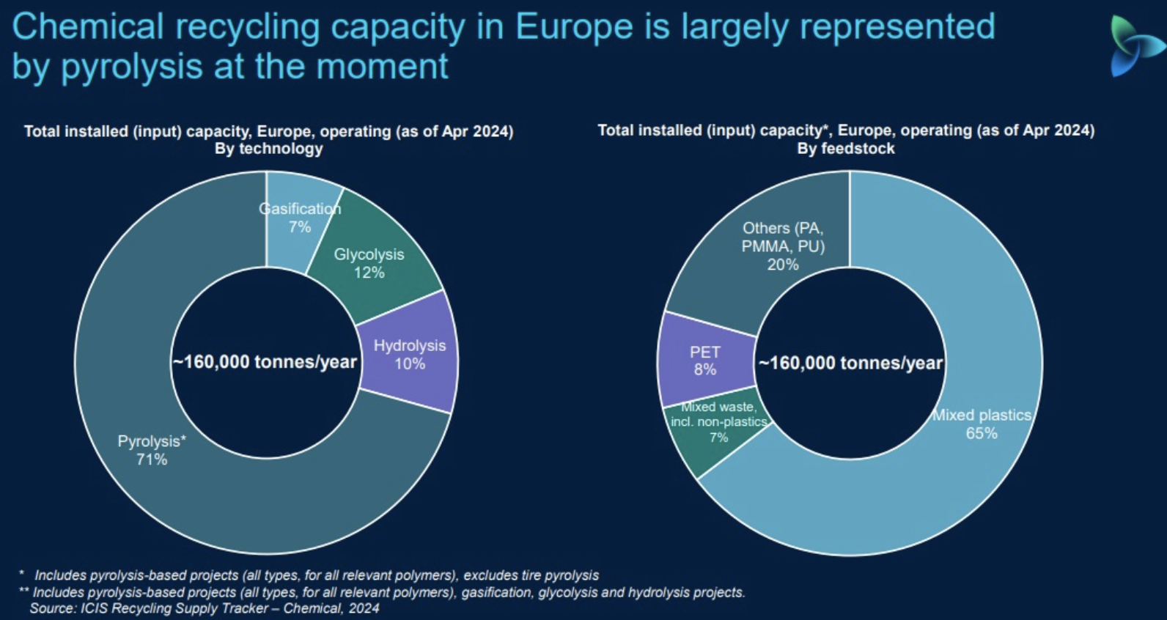
EU use of recycled plastics (2018)
References:
[1] https://www.mdpi.com/2313-4321/3/1/1
[2] https://www.mdpi.com/1996-1944/14/17/4782
[3] https://www.bpf.co.uk/hub/chemical-recycling-non-mechanical-capacity.aspx

Slide 20
Average Recycling Weightings
w.t = 0.2**
Mechanical
w.t = 0,32*
w.t = 0.12* x 0.1** = 0.012
Recycling
Glycolysis
w.t = 0.02** x 0.1** = 0.002
Methanolysis
w.t = 0.10**
Solvolysis
Chemical
w.t = 0.71* x 0.1** = 0.073
Resin
Thermal
Pyrolysis
w.t = 0.43*
Incineration
w.t = 0.07* x 0.1** = 0.007
Gasification
Hydrogenolysis
w.t = 0.08** x 0.1** = 0.008
Hydrothermal Tretmant
Hydrocracking
w.t = 0.10**
Liquification
w.t = 0.25*
Dissolution
Landfill
* - Taken from graphs
** - Approximation

Slide 21
PET Recycling
w.t = 0.2
kgCO2-eq /1 ton = 660
MJ / 1 ton = 11300
Collection
Reprocessing
Sorting
Mechanical
Combustion + Energy recovery
Compaction
Landfill
Glycolysis
Ethylene glycol
Repolymerisation
w.t = 0.0125
kg CO2-eq/ 1ton = 2590
MJ /1 ton = 39000
Depolymerisation
Finishing
Collection
Solvolysis
Methanolysis
Fine filtration
Spinning
Methanol
Repolymerisation
kg CO2-eq/ ton = 4814.767
MJ / ton = 19368.82
Chemical
Collection
Sorting
w.t =0.0029
kg CO2-eq /1 ton = 3080
MJ / 1 ton = 51000
PET
Sorting
Pyrolysis
Thermal
Reprocessing
Collection
Sorting
Hydrothermal Tretmant
Combustion + Energy recovery
Landfill
w.t =0.083
kg CO2-eq / ton = 1700
MJ / ton = 12140
Compaction
Combustion
Treatment
Pyrolysis
Incineration
w.t = 0.43
kg CO2-eq / ton = 7300
MJ / ton = 6450
Sorting
Reprocessing
Collection
Combustion + Energy recovery
Landfill
w.t = 0.018
kg CO2-eq / ton = 2020
MJ / ton = -11400
Landfill
w.t = 0.25
kg CO2-eq / ton = 5300
MJ / ton = 51590
Compaction
Combustion
Treatment
Hydrogenation
* - Approximation

Slide 22
HDPE Recycling
w.t = 0.2
kg CO2-eq / 1 ton = 630
MJ/ ton = 8650
Collection
Reprocessing
Sorting
Mechanical
Combustion + Energy recovery
Compaction
Landfill
Thermal
Pyrolysis
Heater
Flash Drum
Heater
Flash Drum
w.t = 0.076
kg CO2-eq / ton= 2557.997
MJ / ton = 29,901.52
Heater
Reactor
Hydrothermal Tretmant
Heater
Flash Drum
Heater
Heater
w.t = 0.044
kg CO2-eq / ton = 1049.399
MJ / ton = 24,528.46
HDPE
Chemical
Flash Drum
Reactor
kg CO2-eq/ ton = 1233.2513
MJ / ton = -883.29
Incineration
w.t = 0.43
kg CO2-eq / ton= 1919
MJ / ton = -14142 (46287)
Landfill
w.t = 0.25
kg CO2-eq / ton = 166
MJ / ton = 464
* - Approximation

Slide 23
LDPE Recycling
Rejection Management
Sorting
Waster water Treatment
Mechanical
w.t = 0.2
kg CO2-eq / ton = 416
MJ / ton = 4720
Washing
extruction
Pelletization
Collection
Incineration
w.t = 0.073
kg CO2-eq / ton = 3348
MJ / 1 ton = 15500
Pyrolysis
Polymerization
Sorting
Pyrolysis
Purification
Hydrocracking
Thermal
Gasification
Collection
Gasification
Separation
w.t = 0.007
kg CO2-eq / ton = 1726
MJ / kg = 19826.96*
kg CO2-eq / ton = 1090.9034
MJ / ton = -809.05
Combustion + Energy recovery
LDPE
Chemical
w.t = 0.013
kg CO2-eq / ton = 127
MJ / kg = 3253.975*
Hydrogenolysis
Collection
Hydrogenolysis
Separation
Hydrothermal Tretmant
Combustion + Energy recovery
Hydrocracking
w.t = 0.013
kg CO2-eq / ton = 214
MJ / kg = 16115*
Collection
Hydrocracking
Separation
Liquification
Combustion + Energy recovery
Incineration
Liquification
Separation
w.t = 0.013
kg CO2-eq / ton = 743
MJ / kg = 6012.276*
w.t = 0.43
kg CO2-eq / ton = 1628.78
MJ / ton = -8443 (1600)
Collection
Combustion + Energy recovery
Landfill
w.t = 0.25
kg CO2-eq / ton = 147
MJ / ton = 440
* - Approximation

Slide 24
PVC Recycling
transporting
granulation
w.t = 0.2
ton CO2-eq/ ton = 0.24 MJ MJ / ton = 110
Mechanical
crushing
sorting
collection
Neutrilasation
Filter
Hydrolysis
hydrolysis
w.t = 0.0027
kg CO2-eq/ ton = 1111
MJ / ton = 1309
Solvolysis
Pre-treatment
Incinerator
w.t = 0.0146
kg CO2-eq/ ton = 1272
MJ / ton = 1142
Chemical
Pyrolysis
Filter
Evaporator
Condenser
Extraction
PVC
Thermal
kg CO2-eq/ ton =
MJ / ton =
Gasification
w.t = 0.0027
kg CO2-eq/ ton = 390
MJ / ton = 1826
Dissolution
w.t = 0.1
kg CO2-eq/ ton = 1729
MJ / ton = 12350
Incineration
Collection
Energy Recovery
w.t = 0.43
kg CO2-eq/ ton = 2177
MJ / ton = 2448
Incineration
Filter
Landfill
w.t = 0.25
kg CO2-eq/ ton = 2750
MJ / ton = 59
* - Approximation

Slide 25
PP Recycling
Collection
Shredding
Drying
w.t = 0.2
kg CO2-eq/ ton = 763.42
MJ = ?
Mechanical
Transportation
Washing
Reforming
Pyrolysis
Collection
Gas Treatment
Energy recovery
Thermal
Pyrolysis
Transporting
w.t = 0.0146
kg CO2-eq/ ton = 619.09
MJ = ?
Oil Upgrading
Transportation
Ash production
Landfill
Chemical
Collection
Transporting
Gasification
w.t = 0.0054
kg CO2-eq/ ton = 807.17
MJ = ?
Transporting
Gas Treatment
Energy recovery
PP
Gasification
Ash production
Landfill
kg CO2-eq/ ton =
MJ / ton =
Dissolution
w.t = 0.1
kg CO2-eq / kg = 1.8
MJ = ?
Incineration
Collection
Flue gas treatment
Incineration
Ash production
w.t = 0.43
kg CO2-eq/ ton = 876.07
MJ = ?
Transportation
Landfill
Landfill
Collection
Transporting
Landiffling
Methane caprture
w.t = 0.25
kg CO2-eq/ ton = 1155.95
MJ = ?
* - Approximation

Slide 26
PS Recycling
Sorting
Washing
Float-sink
Mechanical
Shredding
Cutting
Drying
w.t = 0.2
kg CO2-eq/ ton = -1950
MJ = ?
Waste water Treatment
Regranulatyion
Pyrolysis
Pre-treatment
Purification/dissolution
w.t = 0.0511
kg CO2-eq/ kg = -0.5
MJ = ?
kg CO2-eq/ ton =
MJ / ton =
Thermal
Pyrolysis
Incineration + Energy recovery
Hydrothermal Tretmant
Sorting
Washing
Float-sink
Cracking
Energy recovery
w.t =0.0189
kg CO2-eq/ ton = -1500
MJ = ?
PS
Chemical
Shredding
Cutting
Drying
Condensation
Waste water Treatment
Densification
Distillation
Hydrogenation
Dissolution
w.t = 0.1
kg CO2-eq/ kg = -0.7
MJ = ?
Incineration
w.t = 0.43
kg CO2-eq/ ton = 1481
MJ = ?
Landfill
w.t = 0.25
kg CO2-eq/ ton = 35
MJ = ?
* - Approximation

Slide 27
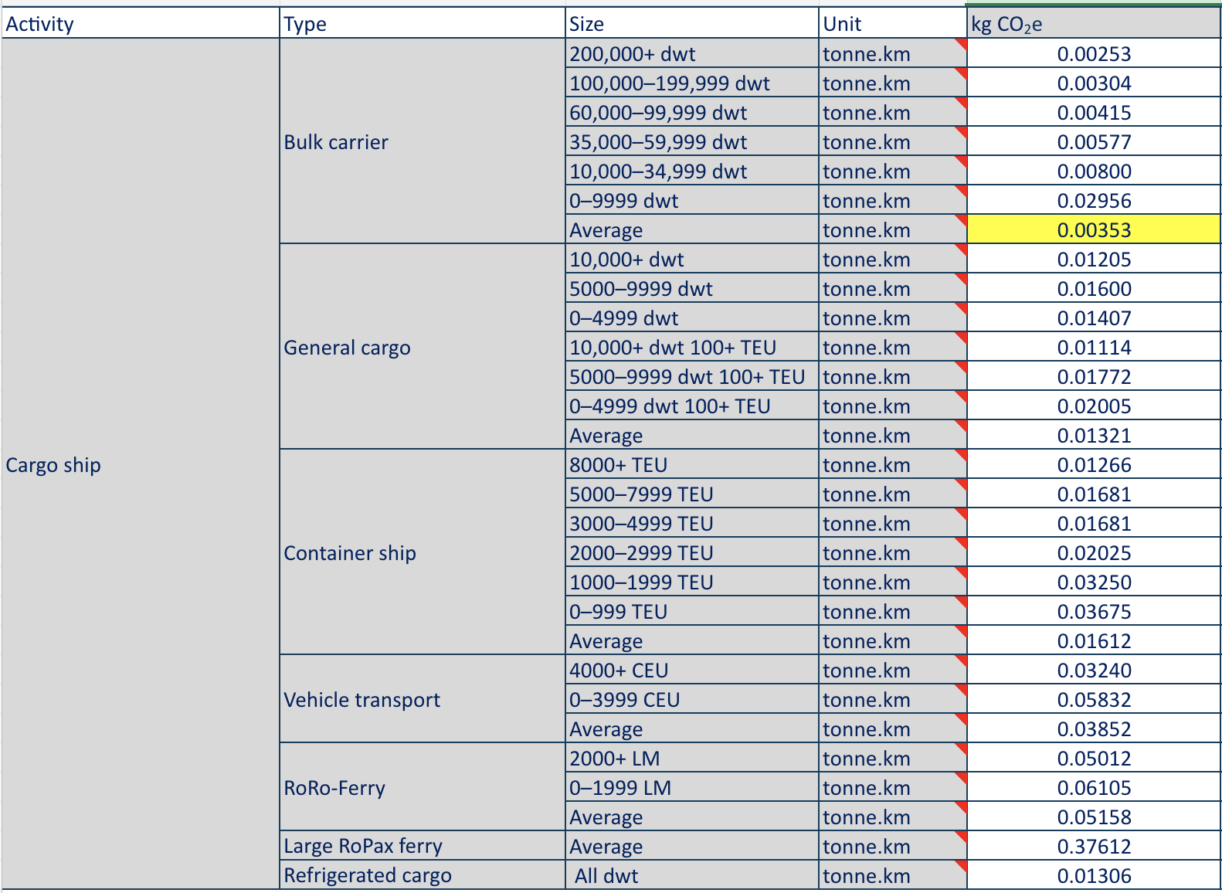
Recycling of Plastics Locations and Trasportation
For the slides below …
https://www.enfplastic.com/directory/plant
https://www.searates.com/services/distances-time

Slide 28
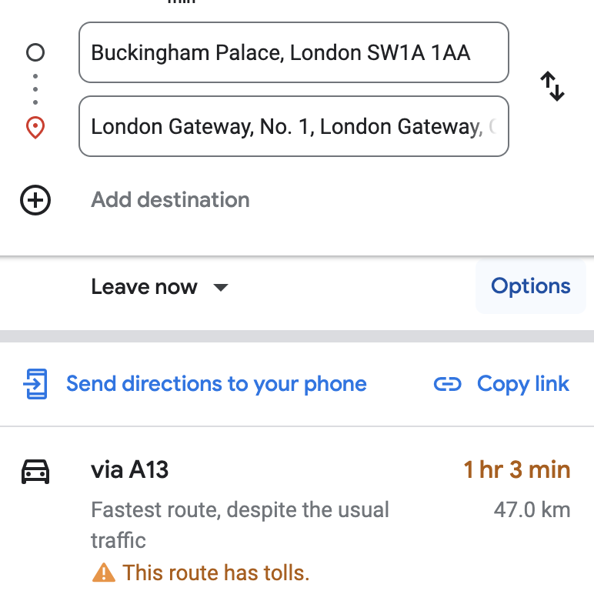






PET Recycling Locations (form lit rev)
By Land: 383 km
-> type:
-> speed: 70 km/h
-> kg co2 eq / ton = 27.6335
-> MJ/ ton = 386.064
By Sea: 675.33km
-> type:
-> speed: 14 knots = 25.928 km/h
-> kg co2 eq / ton = 2.3839
-> MJ/ ton = 33.0912
Overall:
-> kg co2 eq / ton = 30.0174
-> MJ/ ton = 419.1312
Mechanical
w.t = 0,2
https://downloads.hindawi.com/journals/ace/2020/8905431.pdf?_gl=1*ccdrl4*_ga*MTc4MzA5ODEzNy4xNzE2OTAxOTI1*_ga_NF5QFMJT5V*MTcxNjkwMTkyNS4xLjAuMTcxNjkwMTkyNS42MC4wLjA.&_ga=2.168528744.838962844.1716901925-1783098137.1716901925
Glycolysis
Solvolysis
Methanolysis
https://www.sciencedirect.com/science/article/pii/S0921344910001618?ref=pdf_download&fr=RR-2&rr=88af20c989be887a
kg co2 eq / ton = 24.8544
MJ/ ton = 275.0164
PET
Chemical
Pyrolysis
By Land: 255km
-> type:
-> speed:
-> kg co2 eq / ton = 18.3983
-> MJ/ ton = 257.04
By Sea: 339 km
-> type:
-> speed: 25.928 km/h
-> kg co2 eq / ton = 1.1967
-> MJ/ ton = 12.4950
Overall:
-> kg co2 eq / ton = 19.595
-> MJ/ ton = 269.535
Thermal
https://onlinelibrary.wiley.com/doi/pdfdirect/10.1002/ep.10078
Hydrothermal Tretmant
w.t = 0,12
By Land: 221km
-> type:
-> speed: 70 km/h
-> kg co2 eq / ton = 15.9452
-> MJ/ ton = 222.7680
By Sea: 4023km
-> type:
-> speed: 25.928 km/h
-> kg co2 eq / ton = 14.2012
-> MJ/ ton = 10.8290
Overall:
-> kg co2 eq / ton = 30.1464
-> MJ/ ton = 233.597
Incineration
w.t = 0,68
https://onlinelibrary.wiley.com/doi/pdfdirect/10.1002/ep.10078
Landfill
* - Approximation

Slide 29





PET Recycling Locations (approx in UK)
By Land: 462km
-> type:
-> speed:
-> kg co2 eq / ton = 33.3333
-> MJ/ ton = 465.6960
w.t =0,33
Mechanical
By Land: 85.4 km
-> type:
-> speed:
-> kg co2 eq / ton = 6.1616
-> MJ/ ton = 86.0832
w.t = 0,07232
Glycolysis
Solvolysis
Methanolysis
Chemical
Pyrolysis
By Land: 54.3 km
-> type:
-> speed:
-> kg co2 eq / ton = 3.9177
-> MJ/ ton = 54.7344
w.t = 0, 1956*
kg co2 eq / ton = 13.0687
MJ/ ton = 182.5819
PET
Thermal
Hydrothermal Tretmant
Incineration
By Land: 31.1 km
-> type:
-> speed:
-> kg co2 eq / ton = 2.2439
-> MJ/ ton = 31.3488
w.t = 0,2623
By Land: 26.6 km
-> type:
-> speed:
-> kg co2 eq / ton = 1.9192
-> MJ/ ton = 26.8128
w.t = 0,13978
Landfill
* - Approximation

Slide 30


HDPE Recycling Locations (form lit rev)
By Land: 216 km
-> type:
-> speed:
-> kg co2 eq / ton = 15.5844
-> MJ/ ton = 217.728
By Sea: 6725 km
-> type:
-> speed:
-> kg co2 eq / ton = 23.7393
-> MJ/ ton = 329.525
Overall:
-> kg co2 eq / ton = 39.3237
-> MJ/ ton = 547.253
Mechanical
w.t = 0,2
https://downloads.hindawi.com/journals/ace/2020/8905431.pdf?_gl=1*ccdrl4*_ga*MTc4MzA5ODEzNy4xNzE2OTAxOTI1*_ga_NF5QFMJT5V*MTcxNjkwMTkyNS4xLjAuMTcxNjkwMTkyNS42MC4wLjA.&_ga=2.168528744.838962844.1716901925-1783098137.1716901925
Thermal
Pyrolysis
https://www.mdpi.com/1420-3049/27/22/8084
Hydrothermal Tretmant
kg co2 eq / ton = 31.5311
MJ/ ton = 439.9886
HDPE
Chemical
By Land: 255 km
-> type:
-> speed:
-> kg co2 eq / ton = 18.3983
-> MJ/ ton = 257.04
By Sea: 339 km
-> type:
-> speed:
-> kg co2 eq / ton = 1.1967
-> MJ/ ton = 16.6110
Overall:
-> kg co2 eq / ton = 19.595
-> MJ/ ton = 273.651
w.t = 0,12
Incineration
By Land: 414 km
-> type:
-> speed:
-> kg co2 eq / ton = 29.8701
-> MJ/ ton = 417.312
By Sea: 418 km
-> type:
-> speed:
-> kg co2 eq / ton = 1.4755
-> MJ/ ton = 20.4820
Overall:
-> kg co2 eq / ton = 31.3456
-> MJ/ ton = 437.794
https://www.sciencedirect.com/science/article/pii/S0360544223009702?ref=pdf_download&fr=RR-2&rr=88b853b8bb2d6531
w.t = 0,68
Landfill
* - Approximation

Slide 31


HDPE Recycling Locations (approx in UK)
By Land: 191 km
-> type:
-> speed:
-> kg co2 eq / ton = 13.7800
-> MJ/ ton = 192.5280
w.t = 0,76
Mechanical
Pyrolysis
By Land: 110 km
-> type:
-> speed:
-> kg co2 eq / ton = 7.9365
-> MJ/ ton = 110.8800
w.t = 0,1722*
Thermal
Hydrothermal Tretmant
HDPE
Chemical
kg co2 eq / ton = 11.9885
MJ/ ton = 167.4976
By Land: 31.1 km
-> type:
-> speed:
-> kg co2 eq / ton = 2.2439
-> MJ/ ton = 31.3488
w.t = 0,0584
Incineration
By Land: 26.6 km
-> type:
-> speed:
-> kg co2 eq / ton = 1.9192
-> MJ/ ton = 26.8128
w.t = 0,0094
Landfill
* - Approximation

Slide 32






LDPE Recycling Locations (form lit rev)
By Land: 60.5 km
-> type:
-> speed:
-> kg co2 eq / ton = 4.3651
-> MJ/ ton = 60.984
By Sea: 3013 .46 km
-> type:
-> speed:
-> kg co2 eq / ton = 10.6375
-> MJ/ ton = 147.6595
Overall:
-> kg co2 eq / ton = 15.0026
-> MJ/ ton = 208.6395
Mechanical
w.t = 0,2
https://www.sciencedirect.com/science/article/pii/S0959652622022247?ref=pdf_download&fr=RR-2&rr=88b82207caa8dd7a
file:///Users/mac/Downloads/BASF_ChemCycling_LCA_Study.pdf
Thermal
Pyrolysis
By Land: 137.4 km
-> type:
-> speed:
-> kg co2 eq / ton = 9.9134
-> MJ/ ton = 138.4992
By Sea: 722 km
-> type:
-> speed:
-> kg co2 eq / ton = 2.5487
-> MJ/ ton = 35.3780
Overall:
-> kg co2 eq / ton = 12.4621
-> MJ/ ton = 173.8772
w.t = 0,105
LDPE
Chemical
Gasification
kg co2 eq / ton = 12.3266
MJ/ ton = 171.9155
Hydrogenolysis
Hydrothermal Tretmant
Hydrocracking
https://pubs.acs.org/doi/pdf/10.1021/acssuschemeng.3c00636
Liquification
By Land: 141.9 km
-> type:
-> speed:
-> kg co2 eq / ton = 10.2381
-> MJ/ ton = 143.0352
By Sea: 367.67 km
-> type:
-> speed:
-> kg co2 eq / ton = 1.2979
-> MJ/ ton = 18.0158
Overall:
-> kg co2 eq / ton = 11.5360
-> MJ/ ton = 161.051
w.t = 0,695
Incineration
https://www.sciencedirect.com/science/article/pii/S0360544223009702?ref=pdf_download&fr=RR-2&rr=88b853b8bb2d6531
Landfill
* - Approximation

Slide 33



LDPE Recycling Locations (approx in UK)
By Land: 191 km
-> type:
-> speed:
-> kg co2 eq / ton = 13.7807
-> MJ/ ton = 192.5280
w.t = 0,015*
Mechanical
By Land: 243 km
-> type:
-> speed:
-> kg co2 eq / ton = 17.5325
-> MJ/ ton = 244.9440
w.t = 0,0245*
Pyrolysis
Thermal
Gasification
Hydrothermal Tretmant
Hydrogenolysis
By Land: 104 km
-> type:
-> speed:
-> kg co2 eq / ton = 7.5036
-> MJ/ ton = 104.8320
w.t = 0,0105*
LDPE
Chemical
kg co2 eq / ton = 2.6519
MJ/ ton = 37.0495
Hydrocracking
Liquification
By Land: 31.1 km
-> type:
-> speed:
-> kg co2 eq / ton = 2.2439
-> MJ/ ton = 31.3488
w.t = 0,35*
Incineration
By Land: 26.6 km
-> type:
-> speed:
-> kg co2 eq / ton = 1.9192
-> MJ/ ton = 26.8128
w.t = 0,60*
Landfill
* - Approximation

Slide 34
PVC Recycling Locations (form lit rev)
Kreißig J, Baitz M, Schmid J, Kleine-Möllhoff P, Mersiowsky I. PVC recovery options concept for environmental and economic system analysis. LeinfeldenEchterdingen: Vinyl 2010 – PE Europe GmbH; 2003.
Mechanical
https://www.escholar.manchester.ac.uk/api/datastream?publicationPid=uk-ac-man-scw:202934&datastreamId=POST-PEER-REVIEW-PUBLISHERS.PDF
Solvolysis
Hydrolysis
Chemical
Pyrolysis
PVC
Thermal
Gasification
https://www.sciencedirect.com/science/article/pii/S0921344919300679?casa_token=NfZdjPDHfH0AAAAA:ICS2th4OHJaYJum1p3EGo2xTMrR0JtCIwORMW1xRgwFLqt0Pl1imClI68BoZ_-R-_PVdnIKB4uE
Dissolution
Incineration
Landfill

Slide 35
PVC Recycling Locations (approx in UK)
Mechanical
Solvolysis
Hydrolysis
Chemical
Pyrolysis
PVC
Thermal
Gasification
Dissolution
Incineration
EcoPark, Advent Way, London N18 3AG
Landfill
Coldharbour Ln, Rainham RM13 9YB

Slide 36
PP Recycling Locations (form lit rev)
Mechanical
Pyrolysis
Thermal
Chemical
Gasification
https://pubs.acs.org/doi/epdf/10.1021/acssuschemeng.0c06311
PP
Dissolution
Incineration
Landfill

Slide 37
PP Recycling Locations (approx in UK)
Mechanical
Pyrolysis
Thermal
Chemical
Gasification
PP
Dissolution
Incineration
EcoPark, Advent Way, London N18 3AG
Landfill
Coldharbour Ln, Rainham RM13 9YB

Slide 38
PS Recycling Locations (form lit rev)
Mechanical
https://www.sciencedirect.com/science/article/pii/S0956053X22004081?ref=pdf_download&fr=RR-2&rr=88c66410194a63f2
Pyrolysis
Thermal
https://www.sciencedirect.com/science/article/pii/S0921344924001538
Hydrothermal Tretmant
PS
https://www.sciencedirect.com/science/article/pii/S0956053X22004081?ref=pdf_download&fr=RR-2&rr=88c66410194a63f2
Chemical
Incineration
https://www.researchgate.net/publication/351690817_Environmental_effects_of_plastic_waste_recycling_-_Focus_on_Climate_Change_effects/link/61543234fd7b3d12155ac65a/download?_tp=eyJjb250ZXh0Ijp7ImZpcnN0UGFnZSI6InB1YmxpY2F0aW9uIiwicGFnZSI6InB1YmxpY2F0aW9uIn19
Landfill

Slide 39
PS Recycling Locations (approx in UK)
Mechanical
Pyrolysis
Thermal
Hydrothermal Tretmant
PS
Chemical
Incineration
EcoPark, Advent Way, London N18 3AG
Landfill
Coldharbour Ln, Rainham RM13 9YB

Slide 40





UK plastics Exports
Reference:
[1] https://www.bpf.co.uk/roadmap
[2] https://www.wrap.ngo/media-centre/press-releases/uk-plastics-pact-latest-report

Slide 41
Overall Recycability Results and Comparisons
Transportation
Resin
Recycling
EU
UK
Total
Globaly
w.t = 0.61
w.t = 0.39
kg co2 eq / ton = 24.8544
MJ/ ton = 275.0164
kg co2 eq / ton = 13.0687
MJ/ ton = 182.5819
PET
kg CO2-eq/ ton = 4814.767
MJ / ton = 19368.82
kg co2 eq / ton = 20.2580
MJ/ ton = 238.9670
GWP = 4835.025
Energy = 19607.787
GWP = 12700*
Energy = ?
kg co2 eq / ton = 31.5311
MJ/ ton = 439.9886
kg co2 eq / ton = 11.9885
MJ/ ton = 167.4976
HDPE
kg CO2-eq/ ton = 1233.2513
MJ / ton = -883.29
kg co2 eq / ton = 23.9095
MJ/ ton = 333.7171
GWP = 1257.161
Energy = -549.573
GWP = 8700
Energy = ?
kg co2 eq / ton = 12.3266
MJ/ ton = 171.9155
kg co2 eq / ton = 2.6519
MJ/ ton = 37.0495
LDPE
kg CO2-eq / ton = 1090.9034
MJ / ton = -809.05
kg co2 eq / ton = 8.5535
MJ/ ton = 119.3178
GWP = 1099.457
Energy = -689.7322
GWP =
Energy = ?
Note: specific case studies resulted in the following values
* -Approximated from Netherland study

Slide 42



Desing Improvements for CASE STUDY
For the slides below …

